Slide 1
Reading Review
Benchmark 3
3/12/12

Slide 2
Drawing conclusions
One day, while Mom was washing dishes in the kitchen, she realized that she had not heard a peep out of three-year-old Holly in a long time. The last time she had seen her, she was playing in the living room with some building blocks. “She sure is being good,” thought Mom.

Slide 3
Why did Mom think Holly was being good?
A. Holly was washing dishes for her.
B. Holly was playing with dolls.
C. Holly was being quiet.

Slide 4
After rinsing the last dish, Mom went to the living room to see what Holly has built. But Holly was not there. “Holly! Where are you?” Mom asked. Mom heard a faraway voice say, “Mommy!” So mom went outside to see if Holly was there.

Slide 5
Why did Mom go outside to look for Holly?
A. Holly’s voice sounded so far away.
B. The last time Mom saw Holly, she was riding her tricycle.
C. Holly said, “I’m outside Mommy.”

Slide 6
Mom looked down the street, up in the tree, and in the backyard, but Holly was not outside. She called her again but did not hear her voice. So, she went back inside. “Holly! Where are you? Come out right now.”

Slide 7
Why did Mom say, “Come out right now.”
A. She was mean.
B. She heard Holly’s voice coming from the closet.
C. She thought Holly might be hiding.

Slide 8
Once again, Mom heard a faraway sound. “Help me!” cried Holly. Mom ran into the bathroom, but Holly was not there. She ran to the garage, but Holly was not there either. Finally, she ran to Holly’s room and saw Holly’s feet sticking out of the toy box, kicking wildly in the air!

Slide 9
What had happened to Holly?
A. She had fallen headfirst into the toy box and could not get out.
B. She was playing with blocks again.
C. She was playing hide-and-seek with Mom.

Slide 10
Mom lifted Holly out of the toy box and asked, “Holly are you alright?” Holly replied, “I think so.” Holly then told Mom that she had been looking for her toy piano because she wanted to play a song for her. “Do you want to hear the song now?” Holly asked. “First, let’s have a special snack. You can play the piano for me later,” Mom suggested. Holly thought that was a great idea!

Slide 11
Where was Holly’s toy piano?
A. The piano was under Holly’s bed.
B. The piano was at the bottom of the toy box.
C. She was playing hide-and-seek with Mom.

Slide 12
Mom and Holly walked to the kitchen. Mom made Holly a bowl of ice cream with chocolate sauce and a cherry on top. Holly told Mom that she wanted to go to the park. Mom really liked that idea.

Slide 13
What will Mom and Holly do next?
A. Mom and Holly will go shopping.
B. Mom and Holly will go for a bike ride.
C. Mom and Holly will play on the swings at the park.

Slide 14
Sequencing
The groups of sentences below are scrambled, put them in the correct order.
A. I took a shower.
B. I got out of bed.
C. I got dressed.

Slide 15
The groups of sentences below are scrambled, put them in the correct order.
A. She planted the seeds.
B. Big pink flowers bloomed.
C. Tiny green shoots came up.

Slide 16
The groups of sentences below are scrambled, put them in the correct order.
A. He ate the sandwich.
B. He spread some jelly on them.
C. He got out two pieces of bread.

Slide 17
The groups of sentences below are scrambled, put them in the correct order.
A. He slide down the slide.
B. He climbed up the ladder.
C. He landed on his feet.

Slide 18
The groups of sentences below are scrambled, put them in the correct order.
A. Firefighters put out the fire.
B. Lightening struck the barn.
C. The barn caught on fire.

Slide 19
The groups of sentences below are scrambled, put them in the correct order.
A. I said, “Okay, do a trick first.
B. Rover whined for a treat.
C. I gave him a dog biscuit.
D. He danced on his hind legs.

Slide 20
The groups of sentences below are scrambled, put them in the correct order.
A. “My name is Emma.”
B. “Hi, what is your name?”
C. “It’s nice to meet you, Emma.”

Slide 21
Fact and Opinion
News or Views? When people talk about things, they often mix news with their own opinions. Write News if the slide is a fact and Views if it is an opinion.

Slide 22
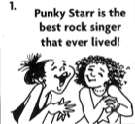
News or Views?

Slide 23
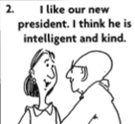
News or Views?

Slide 24
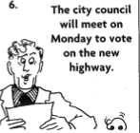
News or Views?

Slide 25
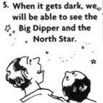
News or Views?

Slide 26
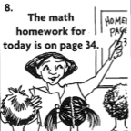
News or Views?

Slide 27
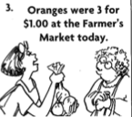
News or Views?

Slide 28
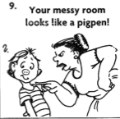
News or Views?

Slide 29
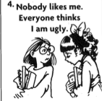
News or Views?

