Slide 1
1-4
Bar Graphs and Histograms
Warm Up
Problem of the Day
Lesson Presentation
Course 2

Slide 2
1-4
Bar Graphs and Histograms
Warm Up
Use the data below to answer the questions.
35, 45, 48, 53, 53, 27, 66, 36, 24
1. What is the mean?
2. What is the median?
3. What is the mode?
4. What is the range?
43
45
53
42
Course 2

Slide 3
1-4
Bar Graphs and Histograms
Problem of the Day
Which number does not belong with the others? Why?
81, 64, 36, 27, 49
Possible answer: 27; the others are perfect squares.
Course 2

Slide 4
1-4
Bar Graphs and Histograms
Learn to display and analyze data in bar graphs and histograms.
Course 2

Slide 5
1-4
Bar Graphs and Histograms
Vocabulary
bar graph
double-bar graph
histogram
Course 2

Slide 6
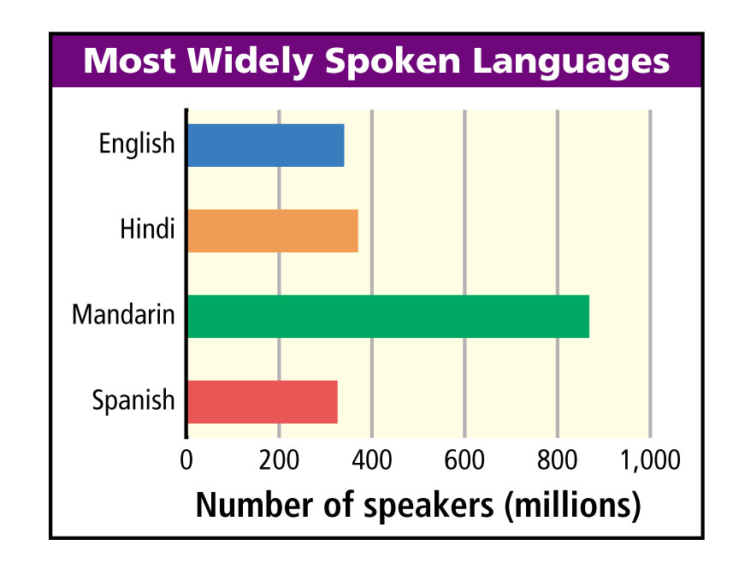
1-4
Bar Graphs and Histograms
Hundreds of different languages are spoken around the world. The graph shows the numbers of native speakers of four languages.
A bar graph can be used to display and compare data. The scale of a bar graph should include all the data values and be easily divided into equal intervals.
Course 2

Slide 7
1-4
Bar Graphs and Histograms
Additional Example 1A: Interpreting a Bar Graph
Use the bar graph to answer the question.
A. Which language has the fewest native speakers?
The bar for Spanish is the shortest, so Spanish has the fewest native speakers.
Course 2

Slide 8
1-4
Bar Graphs and Histograms
Additional Example 1B: Interpreting a Bar Graph
Use the bar graph to answer the question.
B. About how many more people speak Hindi than Spanish?
About 50 million more people speak Hindi than speak Spanish.
Course 2

Slide 9
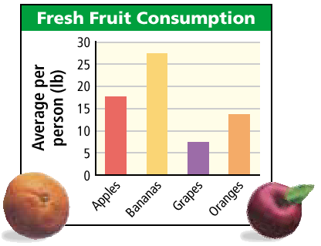
1-4
Bar Graphs and Histograms
Try This: Example 1A
Use the bar graph to answer the question.
A. Which fruit was eaten the most?
The bar for bananas is the longest, so bananas were eaten the most.
Course 2

Slide 10
1-4
Bar Graphs and Histograms
Try This: Example 1B
Use the bar graph to answer the question.
B. About how many more pounds of apples than pounds of grapes were eaten per person?
About 10 pounds more apples were eaten than grapes per person.
Course 2

Slide 11
1-4
Bar Graphs and Histograms
You can use a double-bar graph to compare two related sets of data.
Course 2

Slide 12
1-4
Bar Graphs and Histograms
Additional Example 2: Making a Double-Bar Graph
The table shows the speed limits of three states on interstate highways. Make a double-bar graph of the data.
Step 1: Choose a scale and interval for the vertical axis.
80
60
40
20
0
State Urban Rural
Florida 65 mi/h 70 mi/h
Texas 70 mi/h 70 mi/h
Vermont 55 mi/h 65 mi/h
Course 2

Slide 13
1-4
Bar Graphs and Histograms
Additional Example 2 Continued
Step 2: Draw a pair of bars for each state’s data. Use different colors to show urban and rural speed limits.
80
60
40
20
0
State Urban Rural
Florida 65 mi/h 70 mi/h
Texas 70 mi/h 70 mi/h
Vermont 55 mi/h 65 mi/h
Course 2

Slide 14
1-4
Bar Graphs and Histograms
Additional Example 2 Continued
Step 3: Label the axes and give the graph a title.
Speed Limit on Rural and Urban Highways
80
60
40
20
0
Miles per hour
State Urban Rural
Florida 65 mi/h 70 mi/h
Texas 70 mi/h 70 mi/h
Vermont 55 mi/h 65 mi/h
FL
TX
VT
Course 2

Slide 15
1-4
Bar Graphs and Histograms
Additional Example 2 Continued
Step 4: Make a key to show what each bar represents.
Speed Limit on Rural and Urban Highways
80
60
40
20
0
Miles per hour
State Urban Rural
Florida 65 mi/h 70 mi/h
Texas 70 mi/h 70 mi/h
Vermont 55 mi/h 65 mi/h
FL
TX
VT
Urban
Rural
Course 2

Slide 16
1-4
Bar Graphs and Histograms
Try This: Example 2
The table shows the number of pets owned by students in two classes.
Step 1: Choose a scale and interval for the vertical axis.
16
12
8
4
0
Pet Class A Class B
Dog 12 14
Cat 9 8
Bird 2 3
Course 2

Slide 17
1-4
Bar Graphs and Histograms
Try This: Example 2
Step 2: Draw a pair of bars for each pet’s data. Use different colors to show class A and class B.
16
12
8
4
0
Pet Class A Class B
Dog 12 14
Cat 9 8
Bird 2 3
Course 2

Slide 18
1-4
Bar Graphs and Histograms
Try This: Example 2
Step 3: Label the axes and give the graph a title.
Pets Owned in Two Classes
16
12
8
4
0
Pet Class A Class B
Dog 12 14
Cat 9 8
Bird 2 3
Number of pets
Dog
Cat
Bird
Course 2

Slide 19
1-4
Bar Graphs and Histograms
Try This: Example 2
Step 4: Make a key to show what each bar represents.
Pets Owned in Two Classes
16
12
8
4
0
Pet Class A Class B
Dog 12 14
Cat 9 8
Bird 2 3
Number of pets
Dog
Cat
Bird
Class A
Class B
Course 2

Slide 20
1-4
Bar Graphs and Histograms
A histogram is a bar graph that shows the frequency of data within equal intervals. There is no space between the bars in a histogram.
Course 2

Slide 21
1-4
Bar Graphs and Histograms
Additional Example 3: Making a Histogram
The table below shows the number of hours students watch TV in one week. Make a histogram of the data.
Step 1: Make a frequency table of the data. Be sure to use equal intervals.
Number of Hours of TV
1 //
2 ////
3 //// ////
4 //// /
5 //// ///
6 ///
7 //// ////
8 ///
9 ////
Number of Hours of TV
Frequency
1–3
15
4–6
17
7–9
17
Course 2

Slide 22
1-4
Bar Graphs and Histograms
Additional Example 3 Continued
Step 2: Choose an appropriate scale and interval for the vertical axis. The greatest value on the scale should be at least as great as the greatest frequency.
20
16
12
8
4
0
Number of Hours of TV
Frequency
1–3
15
4–6
17
7–9
17
Course 2

Slide 23
1-4
Bar Graphs and Histograms
Additional Example 3 Continued
Step 3: Draw a bar graph for each interval. The height of the bar is the frequency for that interval. Bars must touch but not overlap.
20
16
12
8
4
0
Number of Hours of TV
Frequency
1–3
15
4–6
17
7–9
17
Course 2

Slide 24
1-4
Bar Graphs and Histograms
Additional Example 3 Continued
Step 4: Label the axes and give the graph a title.
Hours of Television Watched
20
16
12
8
4
0
Number of Hours of TV
Frequency
Frequency
1–3
15
4–6
17
7–9
17
1–3
4–6
7–9
Hours
Course 2

Slide 25
1-4
Bar Graphs and Histograms
Try This: Example 3
The table below shows the number of hats a group of students own. Make a histogram of the data.
Step 1: Make a frequency table of the data. Be sure to use equal intervals.
Number of Hats Owned
Frequency
1 //
2 ////
3 //// /
4 //// /
5 //// ///
6 ////
7 //// /
8 //// ////
9 //// ////
Number of Hats Owned
Frequency
1–3
12
4–6
18
7–9
24
Course 2

Slide 26
1-4
Bar Graphs and Histograms
Try This: Example 3
Step 2: Choose an appropriate scale and interval for the vertical axis. The greatest value on the scale should be at least as great as the greatest frequency.
30
25
20
15
10
5
0
Number of Hats Owned
Frequency
1–3
12
4–6
18
7–9
24
Course 2

Slide 27
1-4
Bar Graphs and Histograms
Try This: Example 3
Step 3: Draw a bar graph for each interval. The height of the bar is the frequency for that interval. Bars must touch but not overlap.
30
25
20
15
10
5
0
Number of Hats Owned
Frequency
1–3
12
4–6
18
7–9
24
Course 2

Slide 28
1-4
Bar Graphs and Histograms
Try This: Example 3
Number of Hats Owned
Step 4: Label the axes and give the graph a title.
30
25
20
15
10
5
0
Number of Hats Owned
Frequency
Frequency
1–3
12
4–6
18
7–9
24
1–3
4–6
7–9
Number of Hats
Course 2

Slide 29
1-4
Bar Graphs and Histograms
Lesson Quiz: Part 1
1. The list shows the number of laps students ran one day. Make a histogram of the data.
4, 7, 9, 12, 3, 6, 10, 15, 12, 5, 18, 2, 5, 10, 7, 12, 11, 15
Number of Laps Run
8
6
4
2
0
Number of Students
0–4
5–9
15–19
10–14
Number of Laps
Course 2

Slide 30
1-4
Bar Graphs and Histograms
Lesson Quiz: Part 2
2. Make a double-bar graph of the data in the table.
Average Number of Laps Run
16
12
8
4
0
Average Number of Laps Run
1990 1995 2000
Boys 12 11 15
Girls 10 8 12
Number of Laps
1990
1995
2000
Boys
Girls
Course 2

