Slide 1
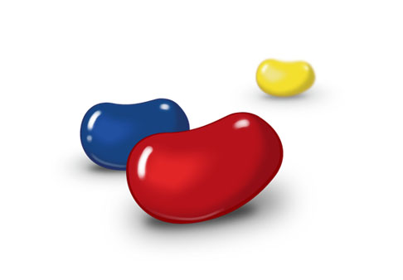
Division is very cool.
I mean it. I love to divide.

Slide 2
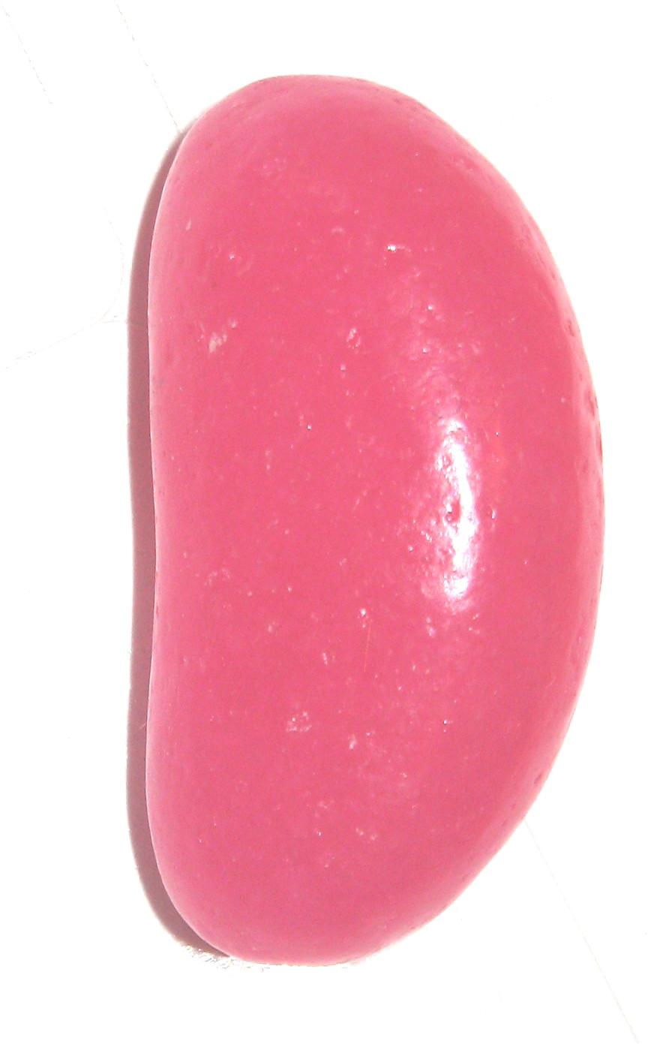
6 ÷ 3 = ___

Slide 3
2

Slide 4
3 ÷ 3 = ___

Slide 5
1

Slide 6
4 ÷ 2 = ___

Slide 7
2

Slide 8
0 ÷ 5 = ___

Slide 9
0

Slide 10
8 ÷ 2 = ___

Slide 11
4

