Slide 1
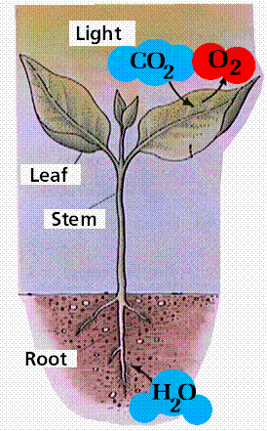
Roots, Stems, and Leaves
Plants differ in shape and size, but most have roots, leaves, and stems. Each part has its own job to do to help the plant survive. Look at this picture and compare it to your plant. Can you find the root, stem, and leaves.
The Science of Living Things: What is a Plant?
A Boooie Kalman Book

Slide 2
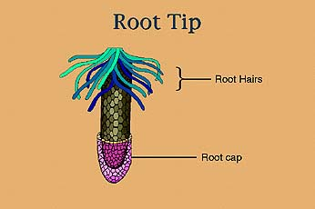
Roots anchor plants in the soil and take in the water and nutrients, which plants use to make food. Tough root caps protect root tips as they grow and push through the soil.
The Science of Living Things: What is a Plant?
A Boooie Kalman Book

Slide 3
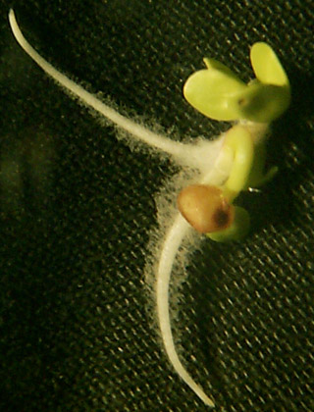
The four main functions of the
root hairs are:
to absorb water,
to anchor the plant,
to store food,
and to let the shoots know how fast to grow.
.
Read more: http://wiki.answers.com/Q/What_is_the_function_of_a_root_hairs#ixzz1UgXcLvdb

Slide 4
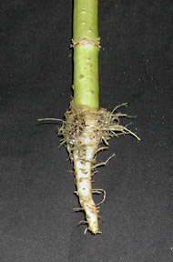
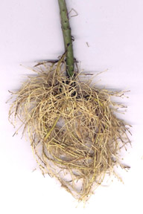
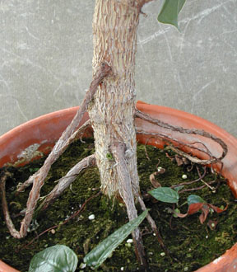
There are three basic types of roots – taproots, fibrous roots, and adventitious roots. Look at your plant and decide what type of root your plant has.
The Science of Living Things: What is a Plant?
A Boooie Kalman Book
taproot
fibrous roots
adventitious roots

Slide 5
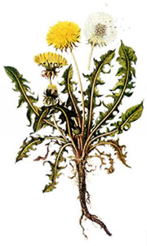
A taproot is a main root that has many smaller roots growing from it. The taproot becomes much larger and thicker as it grows.
A dandelion has a taproot.
The Science of Living Things: What is a Plant?
A Boooie Kalman Book

Slide 6
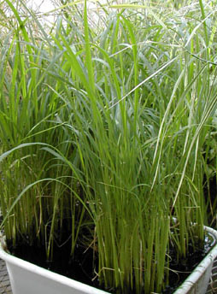
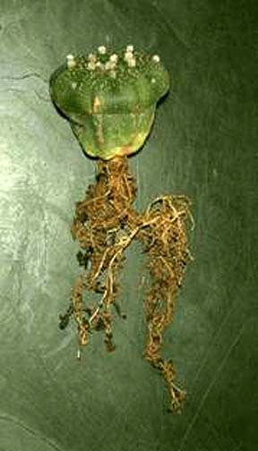
Fibrous roots are thin roots that branch out in all directions near the surface of the ground. Many grasses and desert plants have fibrous roots to help them trap as much water as possible from the morning dew.
The Science of Living Things: What is a Plant?
A Boooie Kalman Book

Slide 7
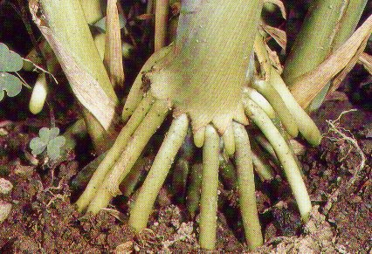
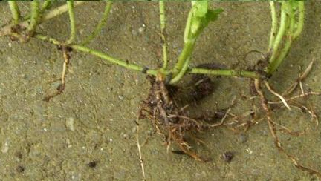
Adventitious roots develop from the stem. They enable plants such as ivy to grow up walls

Slide 8
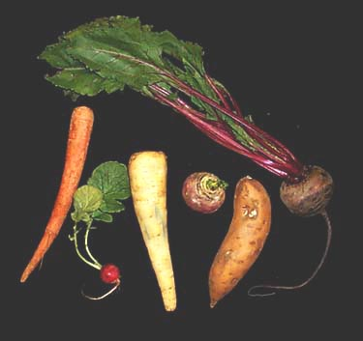
Some roots are edible. Do you think that your plant has an edible root?

Slide 9
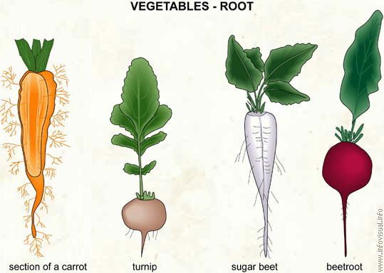
Edible Root

Slide 10
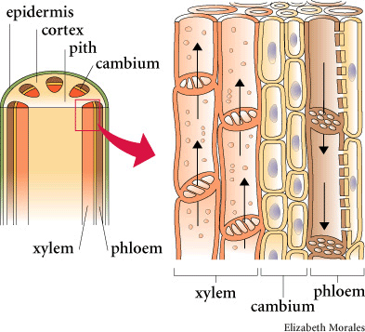
A network of tubes called the vascular system connects all the parts of a plant

Slide 11
One set of tubes, called the xylem, carries water and nutrients form the roots to the stem, leaves, and flowers.

Slide 12
Another set, called the phloem, carries food from th eleaves to the rest of the plant.

Slide 13
The soft tissue in the center of the plant is the pith. Pith cells store extra food.

Slide 14
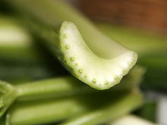
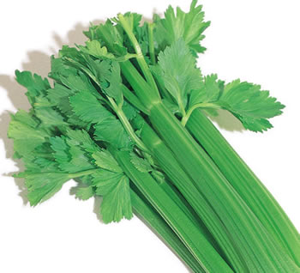
Most stems hold plants upright.
Look at you piece of celery. Can you see the tubes? Can you locate the pith?

Slide 15
Most stems hold plants upright. Why do you think this is important for the plant?
Think about a plant’s needs: water, sun, nutrients, air.

Slide 16
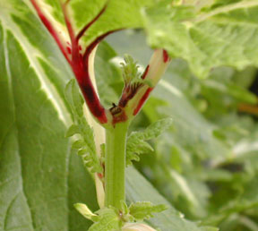
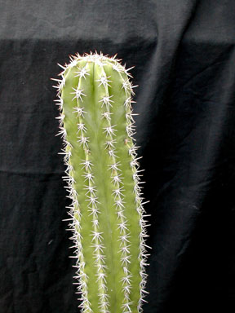
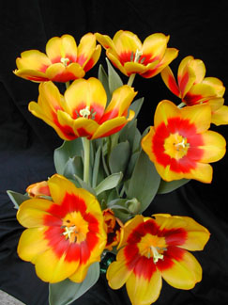
Stems can look very different from plant to plant.

Slide 17
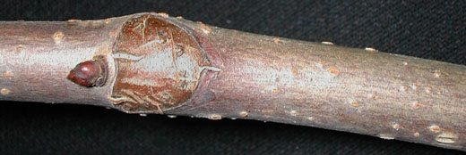
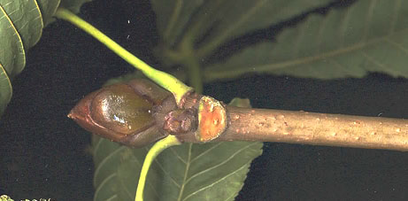
A Twig is a Stem

Slide 18
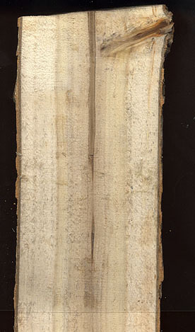
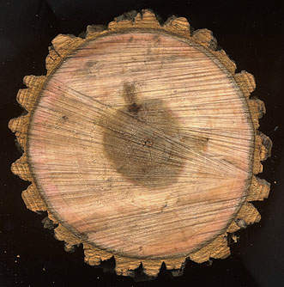
A tree trunk is a
big woody stem.

Slide 19
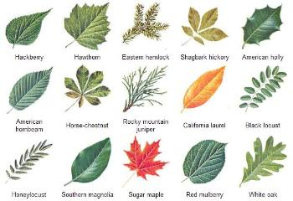
You can identify a plant by the structure of its leaves. A leaf can have one leaf blade or several leaf blades.

Slide 20
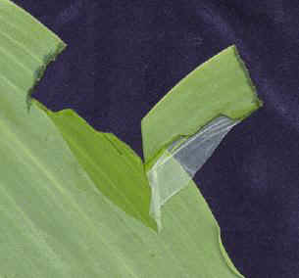
The epidermis, or skin of most leaves is covered with a waxy coating called the cuticle. The cuticle protects the leaf and keeps it moist.

Slide 21
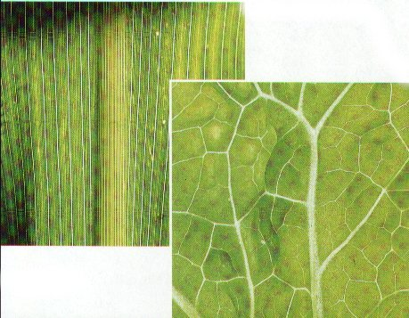
The arrangement of veins in a leaf follows two types of patterns.
Grasses and Corn Plants have Parallel veins that are in long lines.
Other leaves have veins that form a Branched network .
Look at your leaves.
Sort them into two groups: leaves with parallel veins, and leaves with a branched network of veins.

Slide 22
Roots, Stems, and Leaves
Plants differ in shape and size, but most have roots, leaves, and stems. Each part has its own job to do to help the plant survive.
Share something new or interesting that you learned today.
The Science of Living Things: What is a Plant?
A Boooie Kalman Book

